Slide 1
MANIFESTO
THEO THOMAS

Slide 2
WHAT MAKES ME A SUITABLE CANDIDATE FOR THE ROLE OF HEAD BOY?
I believe that I am the suitable candidate for the position of head boy as I have a vast amount of experience in leadership and organisational roles as well as being a passionate and dedicated member of the school community.
I am currently an Equality Awareness Representative, a role in which I champion equality and diversity within the school. As a part of this I, with others, presented assemblies to lower school students – the first of which discussed racism. Over the coming months we will be delivering further assemblies on sexism and other topics we feel are important to creating an even more accepting school environment.
My other responsibilities include being a house leader, a part of the school Oxfam Club and a peer mentor. Alongside these I have also volunteered my time to many different events such as Y13 Parents Evening and Scott House’s Row across Antarctica.

Slide 3
RECOGNISING STAFF ACHIEVEMENTS
If I were elected as your Head Boy, I would endeavour to put in place a short awards ceremony for the staff who make a positive impact upon our lives every day. The nominations would be an extension of the student voice initiative, meaning you, as students can have your say. I would ask that students give a short explanation about why they have nominated their staff member and these would be read out at the end of year assembly.
INCENTIVES FOR PREFECTS AND
HOUSE LEADERS
Another idea that I have the aim of implementing is rewarding the current house leaders and senior prefects for the work that they do within the Roundwood community. I would do this by putting on an event to celebrate their efforts and would discuss other benefits with the SLT such as early lunch passes.

Slide 4
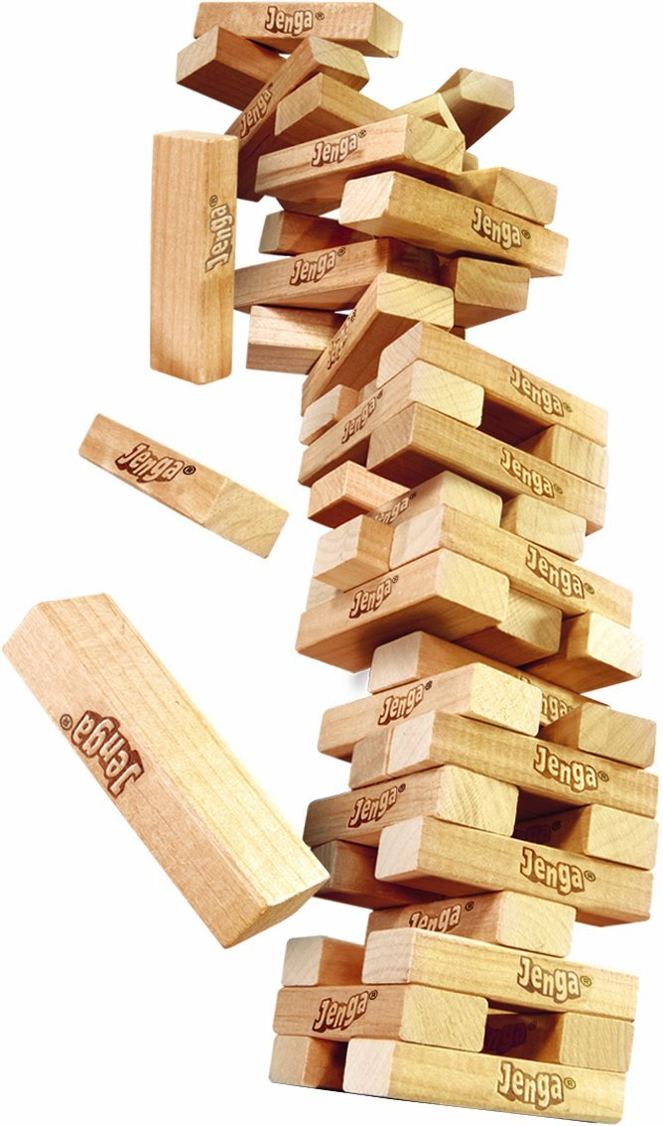
MIXED GAMES ROOMS
Whilst supervising a games room as a part of my current role as house leader, I have had a chance to witness strong friendships between year 7 and 8 students. In my opinion, this is a very positive thing for both years and I think it is something we should encourage across the school. Therefore I would look to introduce mixed games rooms at lunchtimes as well as organising regular form time events in order to promote increased connections between school years.

