Slide 1
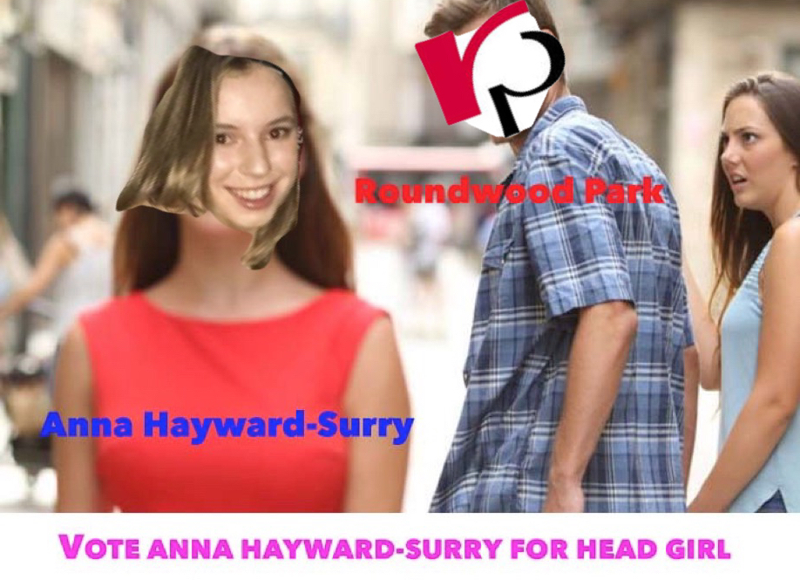
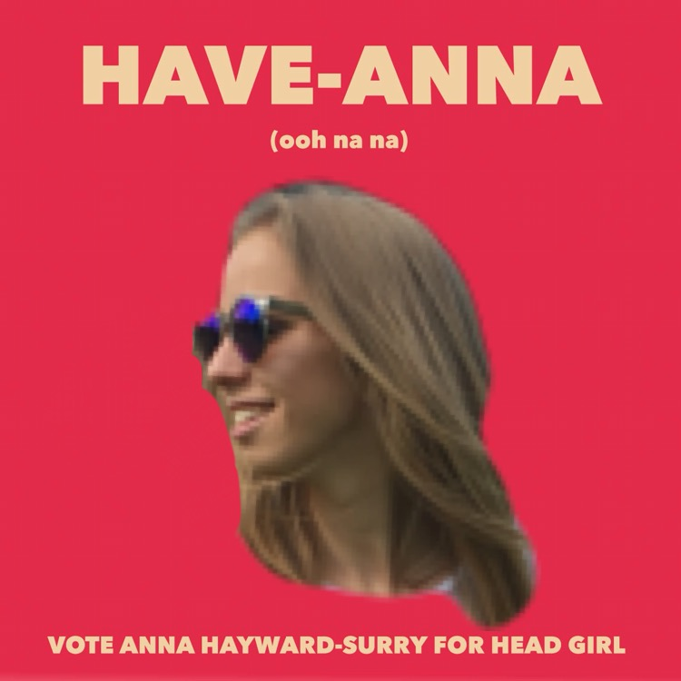
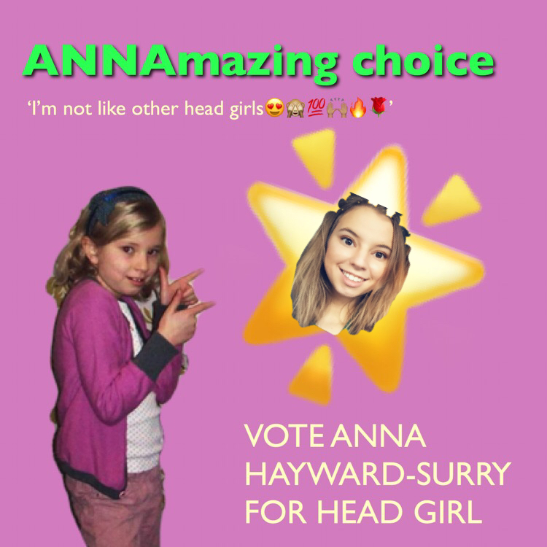
Anna Hayward-Surry
Head Girl Manifesto 2018/2019

Slide 2
How would I aim to improve the school?
I would like to improve the recognition of ‘scholars’ of core subjects, such as English, Maths and Science. I believe that if the core subjects were to give out badges, it would give students something to work towards on a long-term basis, and let students know that their efforts are recognised continually in a more permanent way than the newly introduced ‘good news note’, which focuses more on short term progress within lessons.
An increase in student led assemblies would be a great way
for pupils to develop confidence within public speaking, as
well as take a proactive role in educating their peers on
subjects they have a genuine interest in.

Slide 3
How would I aim to improve the school?
I would hope to be able to expand the food choices in the canteen, to make it more accessible for vegans and vegetarians as well as gluten free students, as there are limited options for them at the moment.
House competitions are a great way for students to showcase their talent and create friendships with like-minded pupils. This is why I think a wider variety of house competitions, instead of mostly sporting events, would help to forge relationships and allow more people to shine.
Additionally, mental health is an increasingly important factor
within every day life. Therefore I believe it would be beneficial
to educate all students about the importance of mental well
being from Year 7, especially with the rise of social media.

Slide 4
Why would I be a good Head Girl?
I am a passionate, high spirited and eager student that would truly love to be your next head girl.
I am bursting with innovative and meaningful ideas that I honestly believe will allow the school to grow even further.
I am reliable and always organised, which would allow me to successfully manage the balance between my academic studies, and the full work load of Head Girl.
I have often been sighted by my teachers and peers as an approachable personality who is easy to work with.

