Slide 1
Year 10 Parents’ Information Evening

Slide 2
GCSEs - What do students and parents need to be aware of?
The new GCSE Reform
Content New and more challenging content
Structure All exams are at the end of the course
Assessment Mainly by examination
Non-exam assessment only where necessary
Tiering Foundation and higher tier permitted only in maths, science and modern foreign languages
Grading New numbered scale (9 to 1 plus U),
9 is the highest The Government ‘good pass’ set at grade 5

Slide 3
Core subjects
English Language and English Literature
GCSE is now assessed solely through end-of course examinations. There is no coursework/controlled assessment element.
All exams are now closed book and students will be required to memorise a number of quotations to enable them to respond meaningfully to questions.
The exams are no longer tiered. All students will sit the same exam.
Spelling, punctuation and grammar (SPaG) will now count for a higher percentage of marks across both exams.
This also means that handwriting needs to be clear and easy to read. An examiner will not mark a question if they cannot read it. This is an issue which affects mainly boys, so start practising clear handwriting in these exams.

Slide 4
Core subjects
Mathematics
Students will complete a two year GCSE course and take their mathematics exam in the summer of year 11.
Assessment consists of 3 Exam papers:
Paper 1: Non-Calculator
Paper 2: Calculator allowed
Paper 3 : Calculator allowed
Each paper contributes 33.3 % of the final mark.
Two Tiers are available
• Higher: grades 5 – 9 are available
• Foundation: grades 1 – 5 are available
Teacher will decide which level of entry for each student. Will also depend on your performance in your upcoming year 10 exams

Slide 5
Core subjects
Science
Students study either separate or combined science
Combined science (2 GCSEs):
Six 1 hour 15 mins exams:
2 Biology,
2 Physics,
2 Chemistry
(16.7% each)
No Coursework
Separate science (3 GCSEs):
Six 1 hour 45 mins exams:
2 Biology,
2 Physics,
2 Chemistry
50% of one GCSE per exam
No Coursework

Slide 6
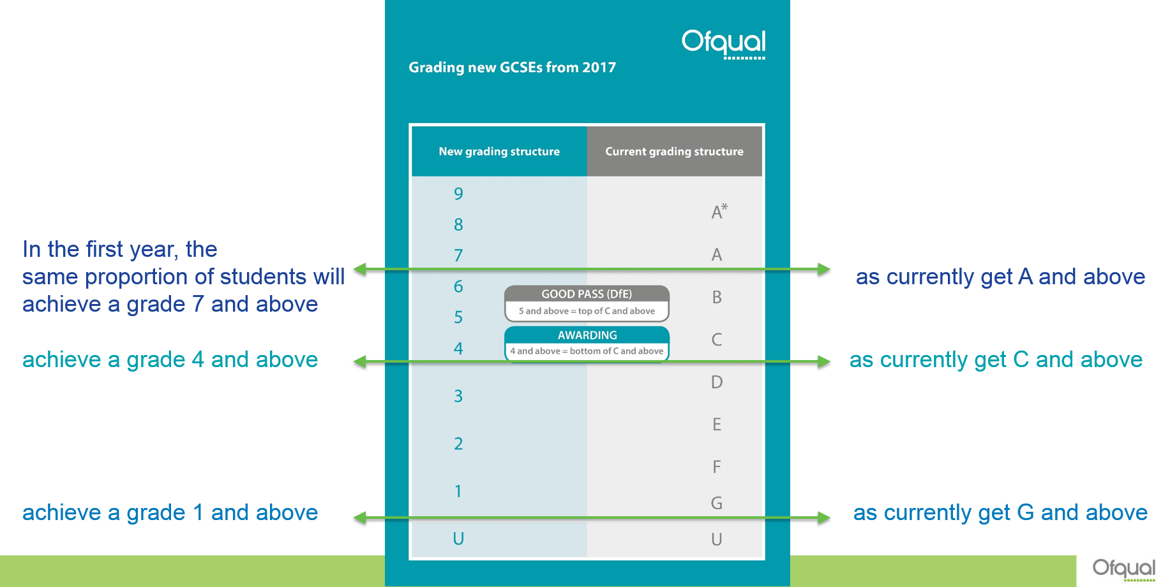
New GCSE grades
Remember – to gain entry to RPS Sixth Form a Grade 5 is seen as a minimum – most further qualifications require a Grade 6 for entry.

Slide 7
Preparation Preparation Preparation
What makes an effective learner?
How can you work in partnership with your teachers?
The route to success in GCSEs …
Notes:
PCu

Slide 8
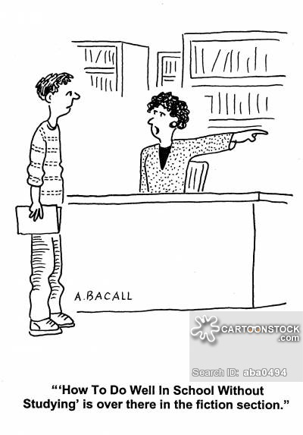

Slide 9
Myths about preparing:
No matter what I do I will not improve my grades
False! Research shows that people who plan and work hard achieve more
I’ll be fine if I just revise the night before the exam
No – if you just read the night before, you’ll forget 70% of it
If I revise now I’ll forget it all by exam time
Actually you won’t “unlearn” it – it will just need refreshing
False! Research shows that people who plan and work hard achieve more
No-one else is revising
Wanna bet?!

Slide 10
Year 10 Exams Students will study at home during these dates and are only required in school for their exam. Personal exam timetables will be sent to each student in due course. Please do not rely on the provisional timetable on the website as timings can change.
Monday 25th March 2019 to
Monday 1st April inclusive
All students return to school on Tuesday 2 April (including those who have Textiles, Art & Food Tech on that day)

Slide 11
So there are 47 days until your first exam

Slide 12
But only 28 school days [approx. 6.4 weeks – 5.4 of them in school]

Slide 13
Preparing (and planning) for GCSEs is vital for success

Slide 14
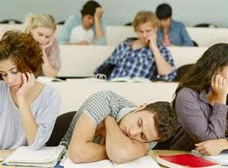
But what sometimes happens?
I can’t do this! It’s too hard - I may as well give up

Slide 15
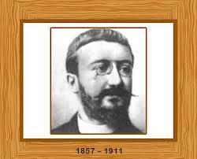
PREVIOUS THEORY: WE ARE BORN WITH INTELLIGENCE AND IT IS FIXED
There is a fixed intelligence that can be measured using an IQ test. No matter how much you learn or how hard you work your intelligence stays the same!
Alfred Binet

Slide 16
Responses we hear a lot from students
“I can’t do ………
Maths I’m just not good at it
English I just don’t understand it
Science as the concepts don’t make sense
History as there is too much writing”

Slide 17
BUT ... most teachers and educators believe there is no such things as:
“I can’t do
Maths I’m just not good at it
English I just don’t understand it
Science as the concepts don’t make sense
History as there is too much writing”
Without
“I can’t do that………. Yet!”

Slide 18
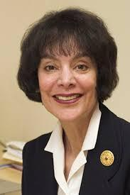
FIXED/GROWTH MINDSET
Carol Dweck , Professor of
Psychology at Stanford University, USA
Known for her work on the mindset psychology trait, she brought together several ideas. Some people believe:
Their intelligence or ability is a fixed trait and
they won’t ever progress further (you are born like it):
Fixed Mindset
whilst others believe their intelligence is a changing
quality that can be improved and developed:
Growth Mindset
Notes:
Carol Dweck professor of psychology at Stanford University one if the world’s leading teaching and research institutions. Some people believe their success is based on the ability they were born with - these are said to have a "fixed" theory of intelligence (fixed mindset). Others, who believe their success is based on hard work, learning, training, determination and perseverance are said to have a "growth" theory of intelligence (growth mindset).

Slide 19
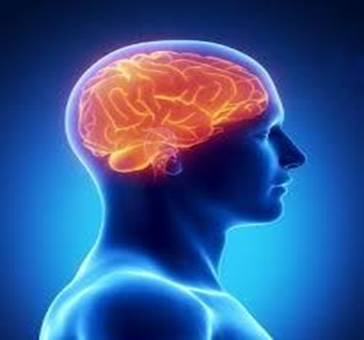
TODAY’S THEORY: GROWTH MINDSET
IN OTHER WORDS…It’s not what you are born with that matters; it’s your mindset that matters:
Every time you work hard and stretch yourself to learn something new - your brain
forms new connections and over time you actually become smarter and better at it
Notes:
Remember your Mindset lessons back in year 7 & 8? Babies are not born able to talk and walk – they just haven’t created the links between the neurons in their brains yet or, as we more commonly say, learned how to do certain things yet. The same applies to your learning.

Slide 20
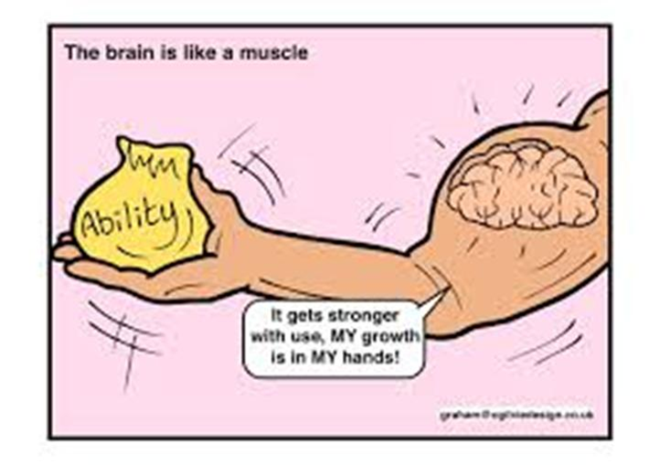
Steps to developing a Growth Mindset
Step #1: Just get started – plan to do something
Step #2 Realize hard work is key
Step #3 Face setbacks, use trial and error to improve performance learn from mistakes
Notes:
Steps to starting to develop a growth mindset with your revision
Accept that the next few months are going to be hard work. Some form of mental stress is NORMAL. It will pass. Easter holidays will follow for R&R.
Learn from your mistakes – whether that is when you are revising (i.e., what works and what doesn’t) or when results come back

Slide 21
Accept that hard work is the key to success!
Fixed Mindset:
Student think learning should come naturally:
“When I have to work really hard in a subject, it means I’m not very smart”
Growth Mindset:
Putting effort into learning and working hard is key:
“The harder I have to work at something, the more effort I put into something, the better I’ll be at it”

Slide 22
Revision is something you plan – it does NOT happen by “magic”
How to plan?
Use subject topic lists to identify areas of weakness
Target knowledge weaknesses
Target question types that you struggle with e.g. Graphs? Long answer questions?
Plan to go over what you have revised MORE than once (short notes only are needed).
Notes:
Start with Topic list – already have this for each subject – should be on the VLE or speak to your teacher if in doubt
Don’t avoid areas that you struggle with or question types that you find hard
Short summary notes using, mind maps, post cards and post-it notes – all good ways of revisiting of what you’ve gone over

Slide 23
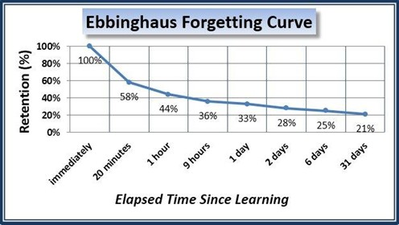
Why do you need to revise each topic more than once?
Surely this means its best to cram it all in at the last minute?
Notes:
Thinking about that last point – why revise more than once: Hermann Ebbinghaus, psychologist, came up with Forgetting Curve which shows how the human brain works at being able to remember ideas fact and information.

Slide 24
Absolutely not: if you revise each topic once, you will only remember part/50% by the time of the exam.
Look at this graph – it shows how much more is remembered every time you go over the work you have revised.
Short, summary notes are best – it is not necessary to do the whole revision session again
“It is the act of retrieving knowledge from long-term memory which strengthens the memory.”
D. Christadoulou, Making Good Progress, (2016).

Slide 25
On GCSE results day who do you want to be?

Slide 26
So when do you start revision?
You start NOW!!!!
DON’T PUT IT OFF – MAKE IT EASIER NOW!
DON’T LEAVE IT UNTIL LATER – ‘LATER’ NEVER COMES.
Notes:
GPe

Slide 27
Revision Success
Plan ahead
Do an audit of where you are now in each subject
Check the syllabus
Know how questions will be asked – what structure and how many marks
Go over past exam questions related to topics you have covered - most past papers can be accessed on the VLE or the Web
Try out sample questions under exam conditions
Notes:
Syllabus – online from the exam board website or teacher

Slide 28
Things to consider:
What commitments do I have such as clubs, tuition, music lessons, sporting commitments etc?
How will I balance these with thorough revision for each subject in preparation for Mock Exams?
How can I pace out revision over the week during school time, half term and while on study leave?
How will a revision plan / timetable work best for me?
Where, when and how will I do my revision?
What resources will I need?
How can my parents best support me?
Notes:
Revision guides, post cards, post –its.

Slide 29
However, don’t forget …
Know your strong and weak subjects – be strategic
Set targets and a timetable - then reward yourself
Find somewhere quiet to revise – no distractions [electronic devices!!!!!! OR TV]
Put your revision and exams into perspective, it’s not forever – but please be genuine with yourself about your level of effort
Manage potential for anxiety: eat well, take regular breaks, exercise and get enough sleep

Slide 30
Why do we ask you to prepare a revision timetable?
Avoids wasting time – you decide in advance what to do in each session
Gets the balance right between revision and leisure time
Maintains routine and discipline for yourself
Helps you to identify what your “time stealers” are and take steps to manage them

Slide 31
Blank Revision Timetables
There are now two versions of the revision timetable on the school website.
Go to:
Students > Student Support Documents > Year 10 Revision Timetable version 1 or version 2

Slide 32
Revision Timetable – Example 1
7.30 - 8.30 | Monday | E | Tuesday | E | Weds | E | Thurs | E | Fri | E | Sat | E | Sun | E
8.40 - 9.40
9.40 - 10.40
Break
11.00 - 12.00
12.00 - 1.00
Lunch
2.20 - 3.20
3.30 - 4.30
4.30 - 5.30
5.30 - 6.30
6.30 - 7.30
7.30 - 8.30
8.30 - 9.30
Personal Time

Slide 33
Example 2 – helps you to check if the revision session worked and was successful.
Colour code the box next to each session to show if you learned something.

Slide 34
Some helpful ways to revise
Post it notes
Story method for key words
Make posters / index cards / flashcards of key points
Mind maps / Spider diagrams
Rhythm and rhyme / Invent a rap, chant or song
Drawing pictures
Recording key notes onto voice memos
Re-writing from memory
Testing with friends
Past papers questions!!
Revision websites/apps – a wealth of resources on-line

Slide 35
Remember…
Attitudes and attendance play a crucial part in exam success - school target is 97%
Enjoy your learning!
Have a healthy balance between work and leisure activities
Manage your stress: eat well, take regular breaks, exercise and get enough sleep
Work hard - Year 10 does go quickly!
Notes:
(PCu) I cannot emphasise enough the need for you to attend school every day and be in all lessons. Research shows a clear link between attendance and attainment. You may think that 90% is a very good score in an exam but when this is your attendance score it is the equivalent of you missing one school day every two weeks. If your score were 80% it would equate to missing a fifth of your schooling which over a five year period is a whole school year! No employer or further education institution would find 90% attendance acceptable and in school, missing this amount of time will definitely damage your chances of reaching your full potential. Missing just one lesson may mean that you miss out on key information or the introduction of a new topic. Starting out behind can often lead to a vicious cycle of not understanding, falling further behind, raising anxiety and then giving up. However, you must keep a balance between your social life, studying and any other commitments such as music or sport. Students who thrive need to remain happy and healthy. They also need a social life. You will feel MUCH better about going out and having fun if you know that your studies are up to date and your work is done. It is definitely possible to have both work and pleasure if you are organised and you have planned well.

Slide 36
Be the driver, not the passenger of your life!
Everybody has more potential than they realise.
Plenty of people prevent themselves from learning just because they don’t believe in their own abilities. Believe in yourself, aim high and take action to reach your full potential!
Good luck! You can do it.
Mrs Cunningham
Mr Pettengell
Mrs Godbee

