Slide 1
How to revise GCSE Science

Slide 2
The process
Identify priority areas
Read revision guide & Notes
Actively use information
AQA questions
& mark schemes

Slide 3
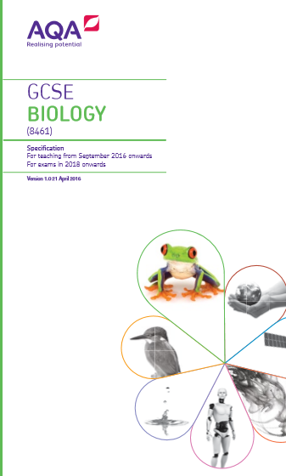
Identify priority areas
Go through the specification and highlight any areas that are a concern
Prioritise these over topics that you feel confident with.
Don’t just start revising from page 1!

Slide 4
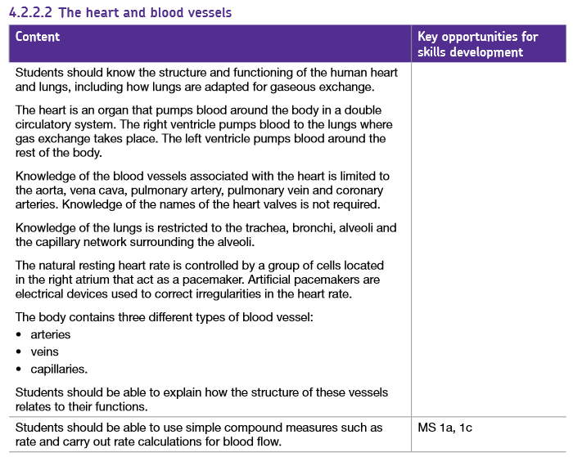
Read revision guide & Notes
Before anything else, you must carefully read through your revision guide and/or notes for the topic you have selected
Top tip:
Start early – If you can do 4 x 10/15 min sessions a week now it will have the biggest impact

Slide 5
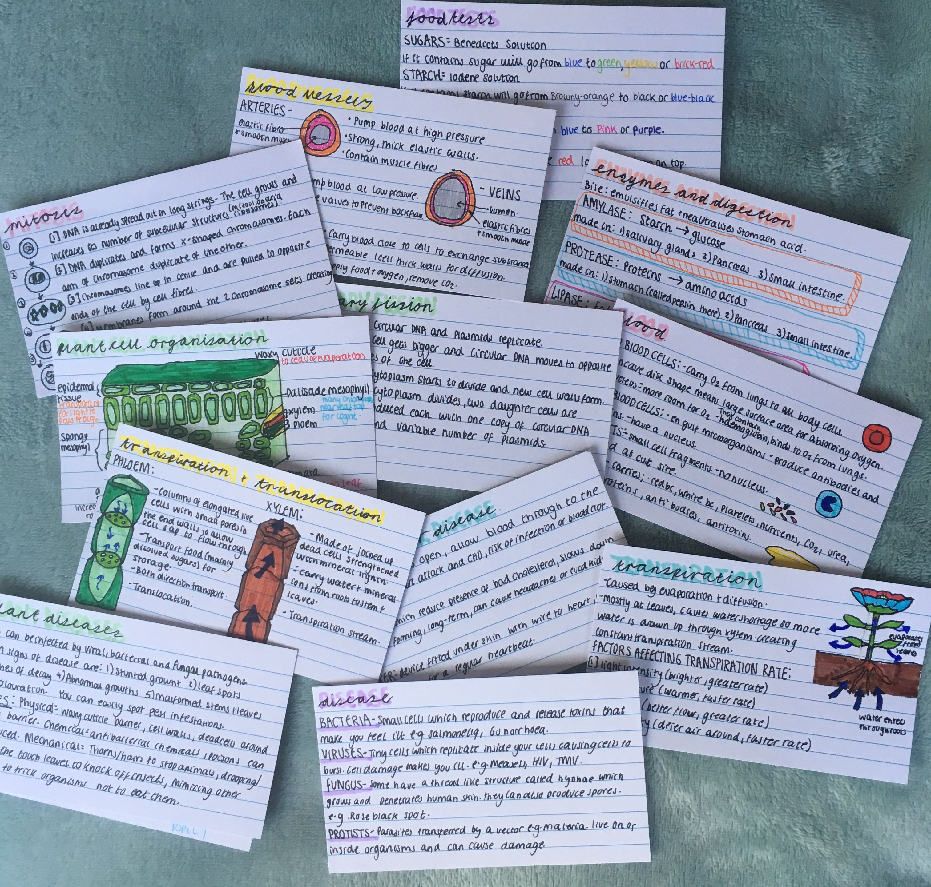
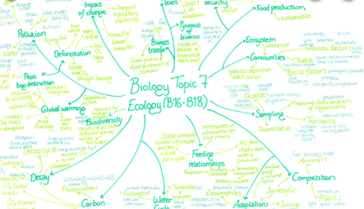
Actively use information
The most important revision tip – You must actually DO SOMETHING with the information you are reading. Reading alone is passive and will have a very limited retention. Its is only when you ACTIVELY USE the information and think about it will you retain it.
Examples:
If the answer is
water is lost by osmosis
What is the question?

Slide 6
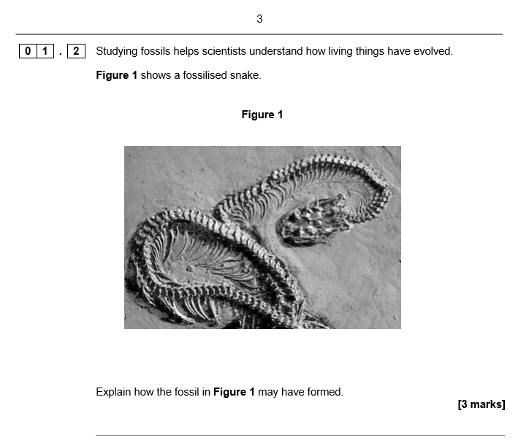
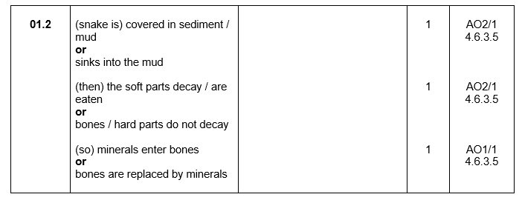
AQA questions & mark schemes
The key to top marks
The only way to know what the examiner is looking for

Slide 7
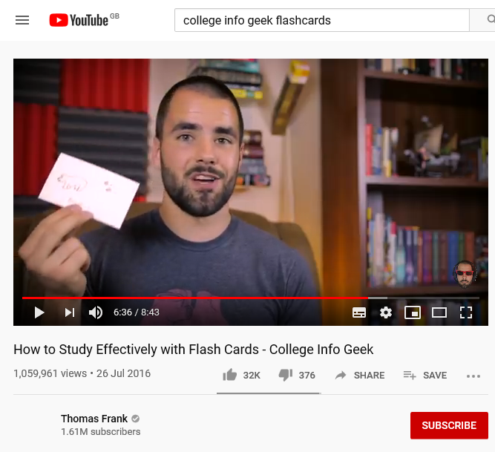
What makes a good flash card?
Use both sides
Limit the amount of information
Use key words
Images help
*DON’T JUST MAKE IT A MINI REVISION GUIDE*
Watch “College Info Geek”

Slide 8
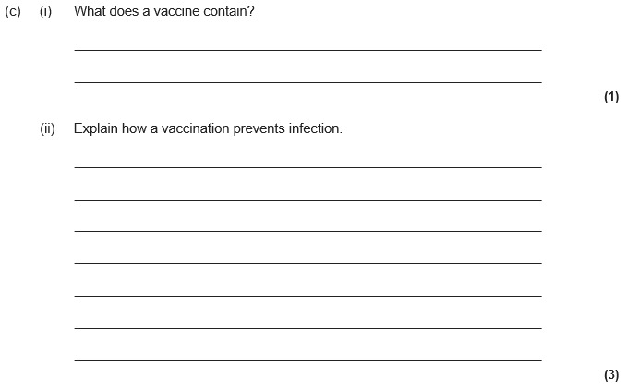

Slide 9
