Slide 1
Roundwood Park SCHOOL EXPRESSIVE ARTS YEAR 6 ASSIGNMENT This is The kind of thing we have been doing in KS3 this term - Have a look and try some of the tasks for yourself! . THEME – Street Entertainment
Please look at the 3 boxes below.
Think which tasks appeal the most and which you would like to explore.
Look at any of the resources on the next slides (they might help you make up your mind)
Choose your task/tasks and get going!
Have fun and get creative!
Drama
ART
Music
1. Research and recreate yourself as a ‘Living Statue’ using creative choices of costume, props and where possible, make up/face paint!
2. Create your own ‘ACTION PHOTO’ street routine like Silviu Caraba with a family member
3. Learn how to make an act with giant bubble blowing!
Drama resources on slide 4
Produce a design for a Graffiti wall inspired by artist Camille Walala and using one of the following methods:
1. Paint, colour pencils or felt pens
2. Collage, using shapes cut out of coloured paper or coloured magazines
3. Use the Street Art app on the Tate website to create your design
Art resources on slide 5
1. Using the app; Bandlab, compose or sequence a piece to represent one of the images on slide 6
2. Create your own ‘Busking’ Performance of a well known song. Are you brave enough to play it live outside?
3. Learn how to create Body Percussion
Music resources on slide 6
We don’t want you to hand anything in but if you would like us to see what you do email m.garbutt@roundwoodpark.co.uk

Slide 2
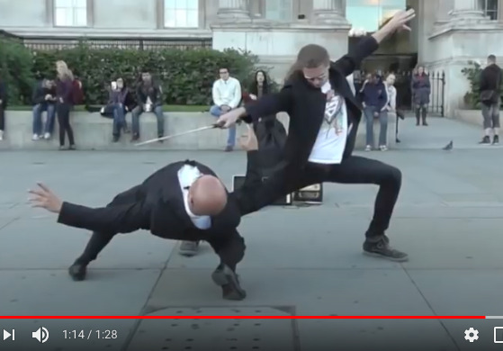
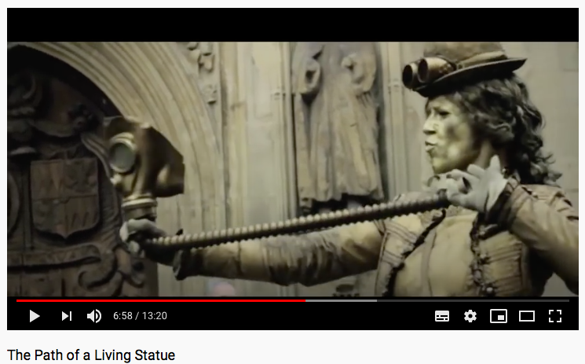
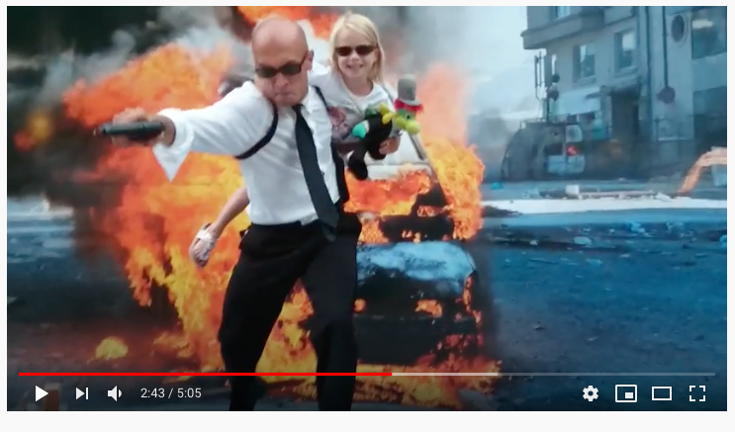
Drama resources
Task 2 – STREET ACTION
PHOTOS
Task 1 – Living Statues
Task 3 Giant Bubble Act
Have a look at Videos featuring
ACTION PHOTO ORIGINATOR
Silviu Caraba
He works with volunteers in the audience to create movie action shots by moving them into position and then placing himself in the image.
Can you create 3 separate action shots in the same way with someone at home? Be safe, careful and really clear with your instructions!!
Your challenge is to recreate something like this but where your partner has no idea what you are trying to show until the end!
https://www.youtube.com/watch?v=eqPYtZYSQLo
https://www.youtube.com/watch?v=lTQIgVFvFYE
Have a look at both of these videos, especially the top one. You may have seen these performers in Covent Garden. Your challenge is to create your own Living Statue and record yourself.
Learn how to make giant bubbles from the video link above then make a video of yourself creating them to an appropriate and atmospheric soundtrack.
https://www.youtube.com/watch?v=vh_iO-yQR6c watch for inspiration
https://www.youtube.com/watch?v=Ek1wn5cV66c
STAY SAFE AND ENJOY YOURSELVES!
https://www.youtube.com/watch?v=QKywJZDt1sg

Slide 3
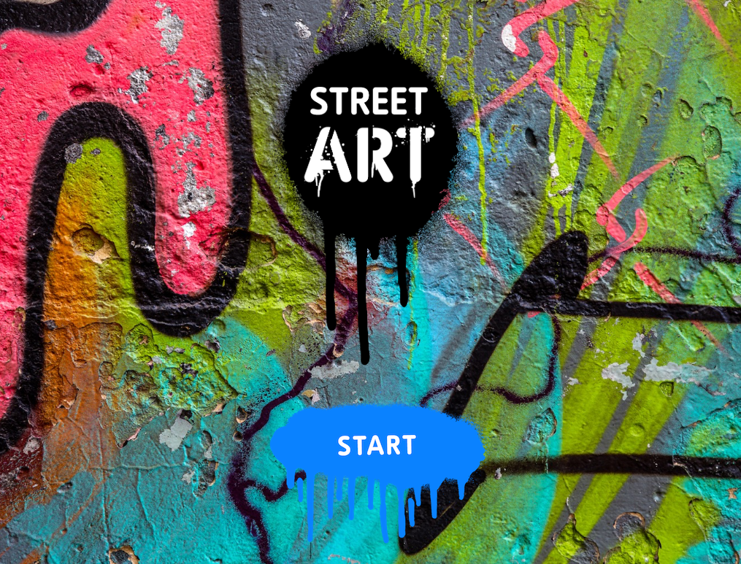
Art resources
Task 3
Use this Street Art online app to help you complete the task.
(Try it anyway as it’s great fun!)
Tasks 1&2
Watch the following video.
Notice the patterns and colour combinations that the artist uses.
https://www.tate.org.uk/kids/explore/kids-view/meet-street-artist
https://www.tate.org.uk/kids/games-quizzes/street-art

Slide 4
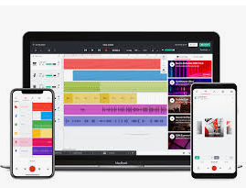
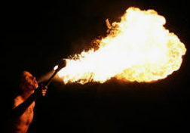
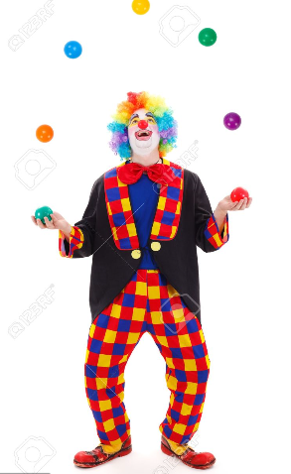
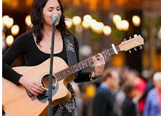
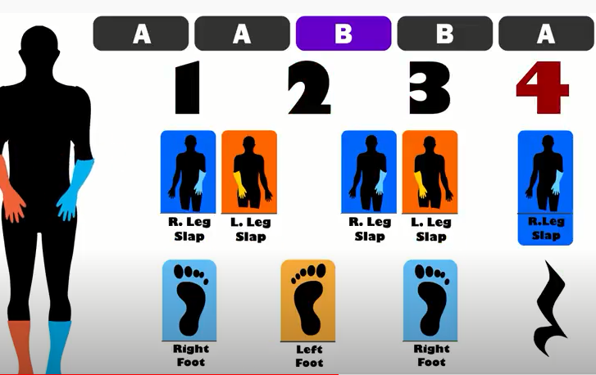
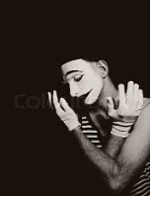
Music Resources
Task 1 – FURTHER HELP AND INFO
Download Band Lab
You should consider all the musical elements such as rhythm, melody, pitch, instrumentation and think about what style would best suit your chosen picture.
Task 2 Busking
No further resources needed but do check back at the details of the task from last week and don’t forget to make a recording of what you produce!
Task 3: Body percussion
Click on the video link to see the lesson. https://www.youtube.com/watch?v=Mnt6O8N6eDg
Once you have mastered the moves and rhythms can you find your own song for it to accompany?
Pic 1
Pic 2
Pic 3

Slide 5
FIND YOUR inspirATION. BE an Inspiration.
Drama
ART
Music
Have fun and we Look Forward to seeing you IN September!!

